Slide 1
Smart 3D Setup and Administration
Smart 3D 2018

Slide 2
Know your instructor
Cherise Primm
Over 7 years of experience working with Smart 3D
Specialization in Setup and Administration, Interference Detection Service, Codeless IFC

Slide 3
Prerequisites for this class
Experience with Microsoft Windows Operating System architecture
Experience with Microsoft SQL Server 2016 or Oracle 12c database server administration
Knowledge of 3D Plant Design CAD Concepts

Slide 4
Agenda
Day 1
Introduction to Smart 3D (concepts, terminology)
System Setup
Project Hardware Sizing
Project Setup (Database Creation, permissions)
Day 2
Backup and Restore
Project Management (delete models, delete catalogs, hierarchy icons, create catalog)
Model Organization (Systems hierarchy)
Smart 3D Common Applications

Slide 5
Agenda (Cont’d)
Day 3
Optimization for Roles
Set Default Colors
Model Data Reuse & Model Data Transform
Synchronize Model with Catalog
Database Maintenance
Database Integrity
Day 4
Error Logs and Memory monitor
Interference Checking Service
Point Cloud Reference
Reference 3D (R3D) Part I
Notes:
Topics to add:
Model Data Transform (MDT)

Slide 6
Agenda (Cont’d)
Day 5
Reference 3D (R3D) Part II
Intergraph Batch Services
Database conversion wizard (SQL ORACLE)
Database version upgrade

Slide 7
Smart 3D Introduction

Slide 8
Smart 3D - Database architecture
Model Configuration
Site
Site Schema
Catalog
Catalog Schema
Model
Reports
Reports Schema
CDB
MDB
RDB
CDB
SCHEMA
RDB
SCHEMA
SDB
SDB
SCHEMA

Slide 9
Smart 3D - Database architecture
Model Configuration
Site
Site Schema
Catalog
Catalog Schema
Model
Reports
Reports Schema

Slide 10
Smart 3D - Database architecture
Model Configuration
Site database set:
Contains configuration and connection information and links the rest of the databases.
Catalog database set:
Contains the Reference Data used by all disciplines.
Store Design Modules (assemblies), Catalog Filters
Model database:
Contains and organizes all of the three-dimensional objects in the model, referenced objects data.
Stores definition and content of deliverables (Drawings and Reports), Model and user’s Filters, Styles, Surface Style Rules, etc.
Reports database set:
Optimize data retrieval from other five databases.
Catalog database set
Model
database
Reports
database set
Site database set

Slide 11
Smart 3D - Database architecture
Model Configuration options
Catalog 1
Model 1
Report 1
Multiple Models can share the same Catalog …
Site 1
Model 2
Report 2
Catalog 2
Model 3
Report 3
… or exclusively use own Catalog

Slide 12
Smart 3D - Database architecture
Model Configuration options
Catalog 1
Model 1
Report 1
Multiple Model can share the same Catalog …
Site 1
Model 2
Report 2
Catalog 2
Model 3
Report 3
… or exclusively use own Catalog
Notes:
12

Slide 13



Smart 3D intro: Server - Client architecture
Database Server
- Name Generator
- SharedContent
Smart 3D Client
Interference Checking Server
Ancillary servers
Smart 3D Client
Batch Server

Slide 14

Smart 3D intro: Define Workspace
Reports Database set
Filter on database
Returns only the data you want to see
and builds a logical “Working Set”
System
Assembly
Spatial (Volume or Planes)
Logical Permission Groups
Object Types/Properties
Model Database
Site Database set
Catalog Database set
Workspace

Slide 15
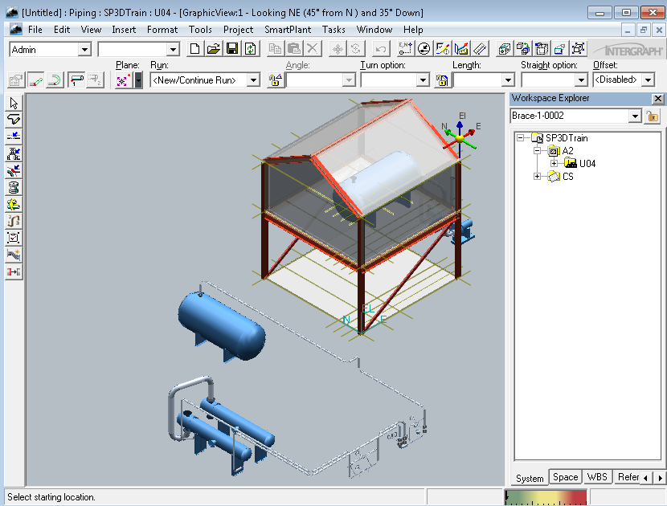
Smart 3D intro: Modeling environment
Access
Control
Main Menu
Common Toolbar
Workspace
Explorer
Discipline oriented interface
Drawings and Reports
Graphic views
Active
command Ribbon bar
Task Toolbar
Active View
To Do list meter
Status Bar

Slide 16
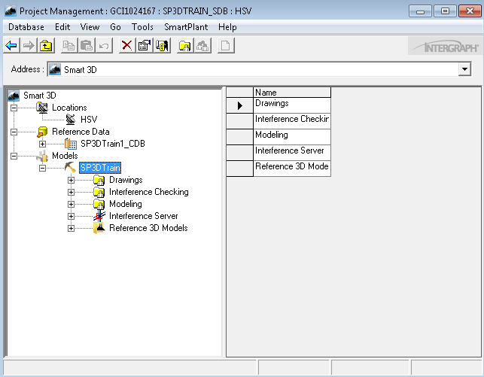
Smart 3D intro: Project Management
Create, backup and restore models
Modify user accesses to model objects
Start/Stop Interference checking
Configure Global Workshare
Migrate databases
Main Menu
Tree view
List view
Permissions
Hierarchy

Slide 17
Smart 3D intro: Relationships and Integration
Smart 3D synchronizes key elements of integration and relationships.
Integration - Smart 3D allows multiple engineering disciplines to work concurrently and in real-time against relational databases.
Relationships - Smart 3D's relationship manager controls design changes across disciplines, which in turn establishes and maintains appropriate behaviors among structures, equipment, and systems.

Slide 18
Smart 3D intro: Administrative guides
Smart 3D Release Bulletin
Smart 3D Installation Guide
Smart 3D Installation Checklist
Smart 3D Project Management User's Guide
Smart 3D Database Integrity Guide
Smart 3D Global Workshare Guide
Smart 3D Interference Checking Guide
Smart 3D Troubleshooting Guide
Smart 3D Point Cloud Guide

Slide 19
System Setup

Slide 20
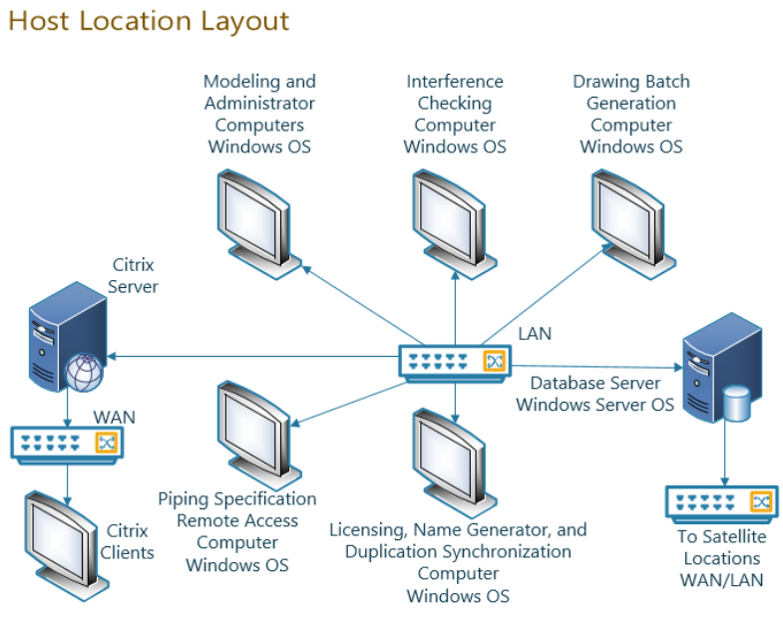

Slide 21
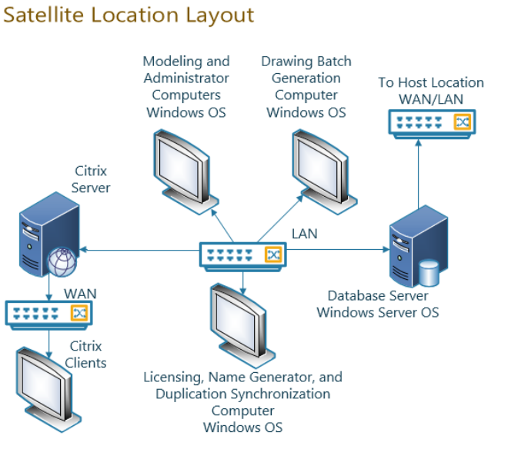

Slide 22
System Setup: Smart 3D servers
One or multiple server machines can be used to provide the following required supporting services:
Database server
Provides hosting services for the Smart 3D databases
Shared content file server
Contains support files for the Smart 3D project, symbol definitions, drawing and reports templates, reference files, translator data, etc.
Name Generator service provider
Generates object names and contains naming rules for object placement and certain administrative functionality

Slide 23
System Setup: Smart 3D ancillary servers
Ancillary servers are computers dedicated to perform a specific task with the purpose to offload processing from the main database server.
Interference checking (IFC)
Checks interferences between objects in the model
Intergraph Batch services
Manages scheduling and execution for commands to be processed in batch mode

Slide 24
System Setup: Smart 3D workstation machines
Workstations connected to the database server
Administrative clients
Used in administrative and maintenance tasks such as backups, restores, bulkload to catalog, database maintenance and integrity checks, attaching external references, manipulations with large data (MDR/MDT)
Modeling clients
Contains all discipline related tasks and commands to create objects in a model
Output clients
Contains all discipline related tasks and commands to create deliverables generated from model

Slide 25
System Setup: Server - Workstation
Hardware recommendations
Supported platforms
Software prerequisites
Installation

Slide 26


System Setup: Hardware recommendations Database server
Intel Xeon® 5600 Series or better (64-bit instruction set, not Itanium®)
32 GB to 128 GB or greater RAM depending on project size
For hard drive size, see “Smart 3D Project Hardware Sizing Recommendations” in the Installation guide
Backup system for server
Access to DVD drive, either locally or through a network connection
1 GbE or higher network interface for client connections, latency should be less than 1ms between client and database server

Slide 27
System Setup: Supported platforms Database server
Supported Operating Systems
Microsoft Windows Server 2016 (Standard or Enterprise)
Oracle Linux 7 (Oracle database only)
Supported Database Servers
Microsoft SQL Server 2016 (Standard edition for stand-alone environments; Enterprise edition for Global Workshare environments; 64-bit)
Oracle 12c Release 2 (12.2.0.1) (Enterprise or Standard Edition 2; 64-bit)
If you are going to use Oracle in a Global Workshare configuration, you also need Oracle GoldenGate 12.3.0.1.2, which is separately purchased from Oracle
Oracle Linux 7 does not support a Global Workshare configuration

Slide 28
System Setup: Software prerequisites Database server
Software prerequisites
Adobe Reader or equivalent PDF reading software
Microsoft XML Core Services (MSXML) 6.0 SP1 (Database server only)
Microsoft .NET 4.6 or later

Slide 29
System Setup: Installation of Smart 3D Reference Data – Name Generator
Reference Data
Shared Content files
Database Templates
Oracle initialization scripts
Name Generator Service

Slide 30
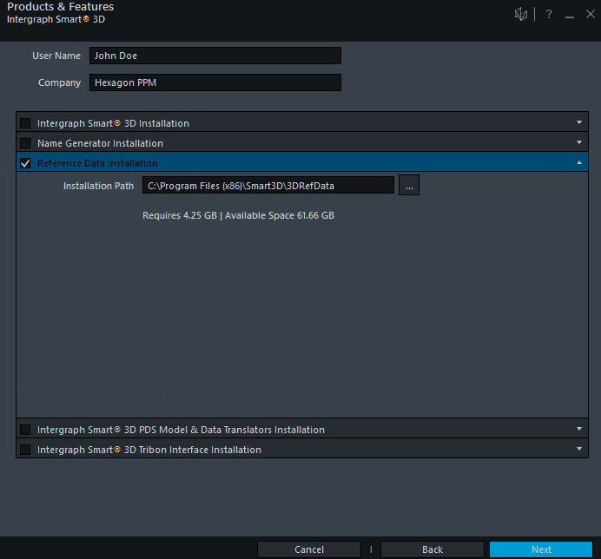
System Setup: Installation of Smart 3D Reference Data

Slide 31
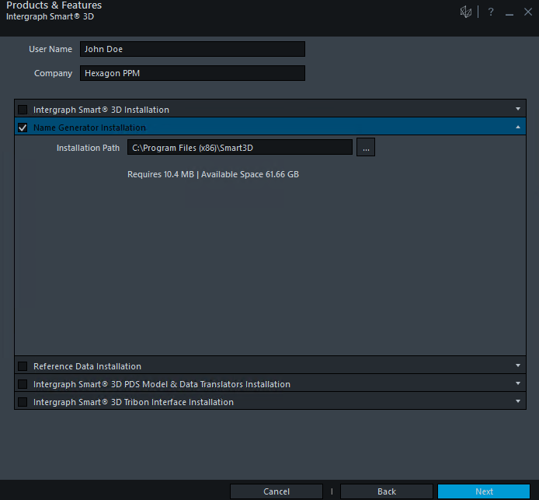
System Setup: Installation of Smart 3D Name Generator

Slide 32

System Setup: Installation of Smart 3D Workstation
Applicable Hardware configurations
Administrative Client workstation
Modeling Client workstation
Interference Detection computer/server
Drawing Batch computer/server
Name Generator computer
Duplication and Synchronization computer
Smart 3D Piping Specification Remote computer

Slide 33
System Setup: Hardware recommendations Workstation
Intel Core i7, Quad Core
6+ GB RAM
Access to a DVD drive, either locally or through a network connection
Monitor capable of a minimum of 1280 x 1024 resolution
1 GbE or higher network interface
Graphics card designed for 3D intensive applications that meet the following requirements:
32-bit main RGBA pixel buffer
Hardware OpenGL 2.1 support
Hardware Z buffer: 24 bit or higher
256 MB RAM
8-bit stencil buffer
Hardware Alpha blending support
Graphics acceleration set to full
Hardware Anti-aliasing support recommended
Latest available drivers should be installed

Slide 34
System Setup: Supported platforms Workstation
Supported Operating Systems and required service packs
Microsoft Windows 7 - Professional or Enterprise SP1 (64-bit)
Microsoft Windows 10 (64-bit)
Microsoft Windows Server 2016 (64-bit) Standard or Enterprise only as a client for Citrix XENApp 7.11
Supported database clients and required versions
Microsoft SQL Server Management Studio 2016 or 2017 (64-bit)
Microsoft SQL Server Native Client 2012 64-bit (11.3.6538.0 or later) (Required for all client computers when using Microsoft SQL Server databases)
Oracle 12c R2 (12.2.0.1); 32-bit Oracle client only (Required for all client computers when using Oracle databases)
NOTE: Oracle Instant client will not work

Slide 35
System Setup: Software prerequisites Workstation
Software prerequisites
Microsoft Edge Browser or Internet Explorer 11 or later
Adobe Reader 11 or later (or equivalent PDF reader software)
Microsoft XML Core Services (MSXML) 6.0 SP1
Microsoft .NET Framework 4.6 or later
Microsoft Office 2016
SmartPlant License Manager 2012 (12.0.9) or later
Notes:
35

Slide 36
System Setup: Optional software Workstation
Intergraph SmartPlant Schema Component 2018
Allows publishing to SPF or 3D Model generation
Intergraph Batch Services 2010 SP1 (6.01.10.00)
Allows scheduling commands for batch and/or remote processing
PDS Data Access components
Allows referencing or export of PDS Projects
Solid Edge Version ST5 and ST10
May be used for creating equipment symbols
Visual Basic 6.0 (Visual Studio 2013 or higher for .NET API)
Allows creation of graphic visual basic symbols, macros, custom rules, etc.
Point Cloud vendor software
Allows referencing Point Cloud projects in Smart 3D
Notes:
36

Slide 37
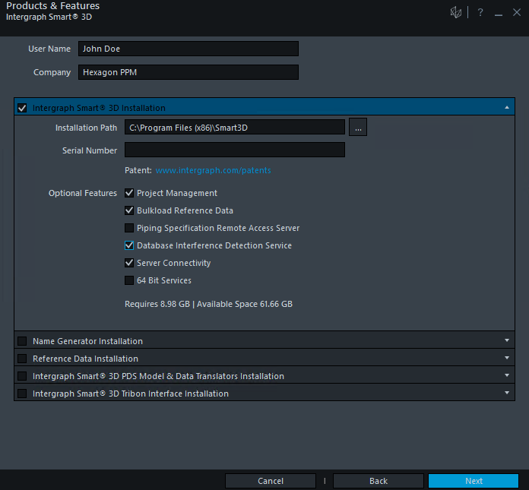
System Setup: Installation of Smart 3D Design /Admin Client Installation

Slide 38

System Setup: Installation of Smart 3D 64-bit Services
64-bit Services can be used for IFC service and/or Drawing Batch Services
These cannot be uninstalled individually. Need to uninstall Smart 3D software.

Slide 39
Setup and Administration Lab
Lab 1

Slide 40
Smart 3D Setup

Slide 41
Smart 3D Setup
Software versioning is based on the different releases.
RTM - Release To Manufacturing (CD/DVD)
Service Packs or Schema Changes
HotFixes
Current version: Smart 3D 2018 (12.00.25.0004)

Slide 42
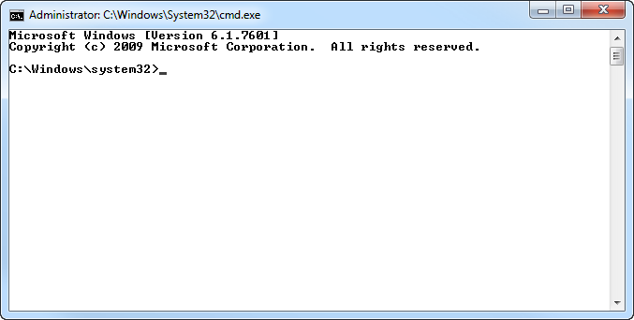
Smart 3D Setup: Silent Install
Smart 3D can be installed through command line
Ideal to reduce deployment and maintenance impact
Service Packs or Hotfixes support silent install

Slide 43
Smart 3D Setup: Silent Install
S3DInstallation.exe SERIALNUMBER=### SLAACCEPT=YES [INSTALLDIR=<Path>] [X64SERVICES=Yes] [ADDLOCAL=Feature1,Feature2] [REMOVE=Feature1,Feature2]

Slide 44
Smart 3D Setup
Three different ways to configure Smart 3D.
Server
Name Generator
Shared Content
Workstation
Project Management
Bulkload
IFC…
Standalone
Global Workshare Configuration

Slide 45
Smart 3D Setup
Before Installing…
Use an account with administrative privileges
If installing under Windows 7, Windows 10 or Windows Server 2016, execute setup.exe with the option “Run as Administrator”
Verify that all prerequisite software was installed
Don't skip any restart recommended by the software

Slide 46
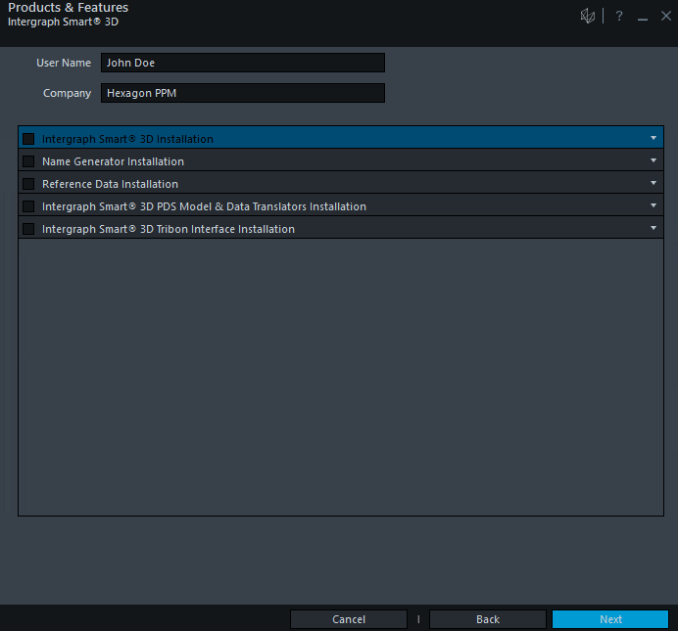
Smart 3D Setup: Splash screen

Slide 47
Smart 3D Setup
Reference Data installation

Slide 48
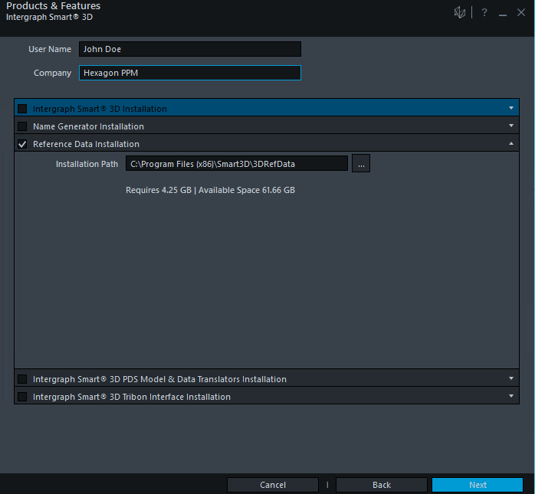
System Setup: Installation of Smart 3D Reference Data
Notes:
Provide User’s and Organization information
Read instruction, act accordingly
Optionally modify installation location (path)
Close Installation wizard (with option to review Smart 3D ReadMe document)

Slide 49
Smart 3D Setup
Name Generator installation

Slide 50
System Setup: Installation of Smart 3D Name Generator
Notes:
Provide User’s and Organization information
Read instruction, act accordingly
Optionally modify installation location (path)
Enter account and password for Name Generator
Close Installation wizard (with option to review Smart 3D ReadMe document)

Slide 51
Smart 3D Setup
Workstation Installation (Design and/or Admin Client)

Slide 52
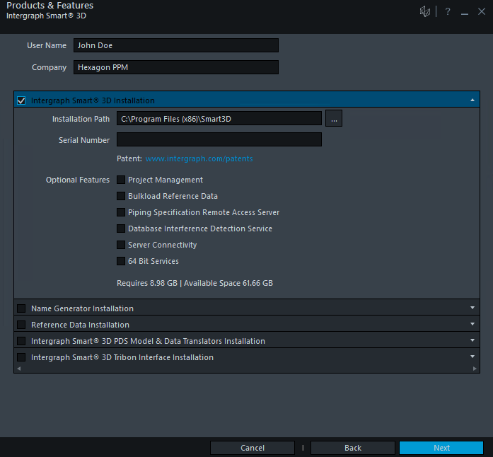
System Setup: Installation of Smart 3D Design Client Installation

Slide 53
System Setup: Installation of Smart 3D Design /Admin Client Installation
Notes:
Provide User’s and Organization information
Read instruction, act accordingly
Optionally modify installation location (path)
Close Installation wizard (with option to review Smart 3D ReadMe document)

Slide 54
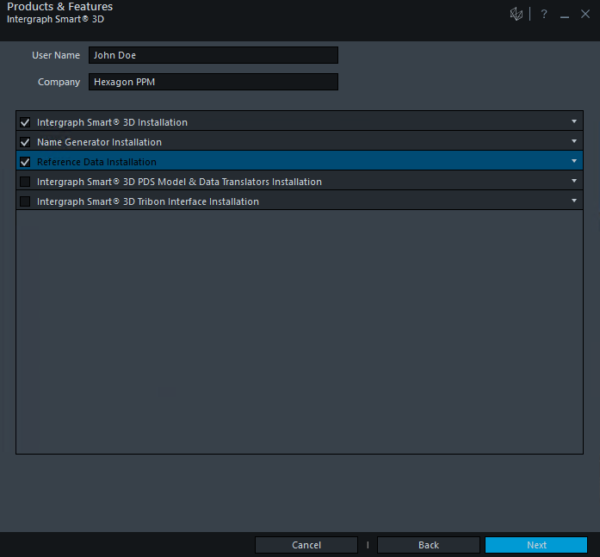
System Setup: Installation of Smart 3D Full Installation
Notes:
Provide User’s and Organization information
Read instruction, act accordingly
Optionally modify installation location (path)
Close Installation wizard (with option to review Smart 3D ReadMe document)

Slide 55
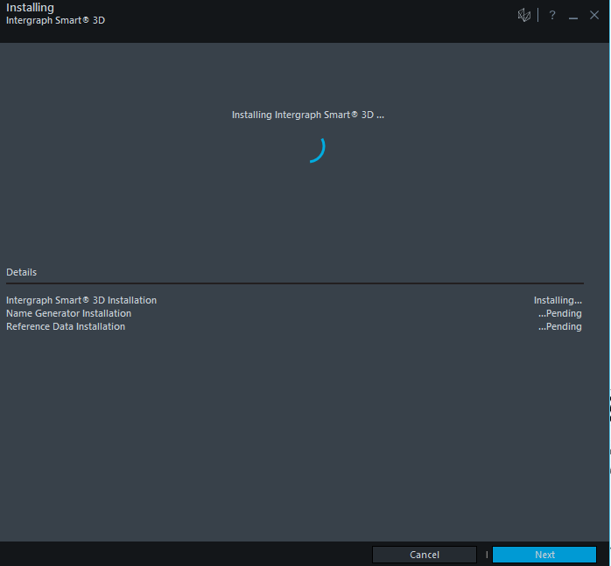
System Setup: Installation of Smart 3D Full Installation

Slide 56
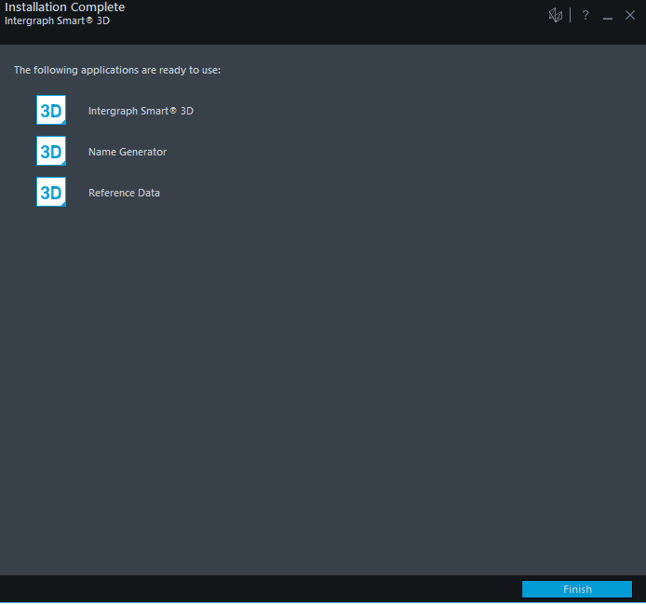
System Setup: Installation of Smart 3D Full Installation

Slide 57
Smart 3D Setup: HotFix installation
Installed through a GUI with similar options to base installation.
Can be installed silently with a script.
HotFixes are listed as updates to Smart 3D in the list of programs.

Slide 58
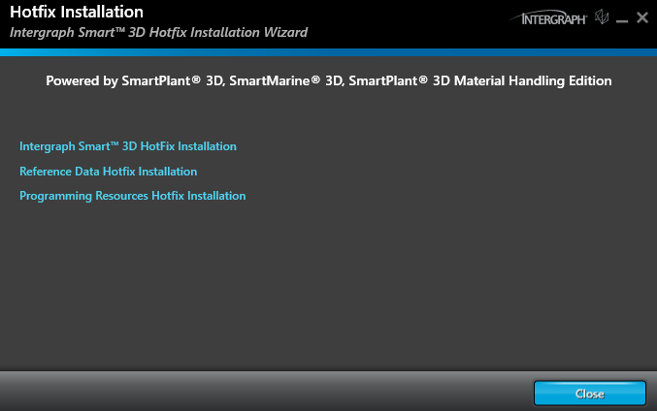
Smart 3D Setup: HotFix installation

Slide 59
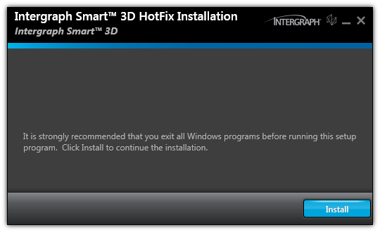
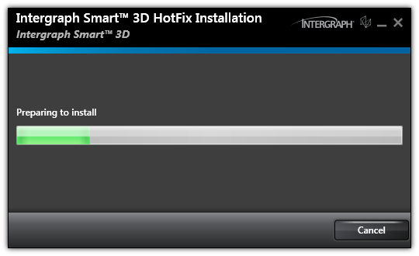
Smart 3D Setup: HotFix installation

Slide 60
Smart 3D Setup: Configurations
Final Configurations for a Workstation
Verify firewall is either turned off or proper exceptions have been set
Register SQL Server on administrative computers or configure the Oracle Net service

Slide 61
Smart 3D Setup: Configurations
Final Configurations for a Reference Data server
Share to the network and adjust proper permissions on the Shared Content folder
Final Configurations for a Name Generator server
Set proper exceptions in the Windows Firewall to allow inbound requests on port 8081

Slide 62
Project Setup

Slide 63
Project Setup: Hardware sizing recommendations
Hardware sizing, especially for servers, depends on many factors such as:
- The number of concurrent users per server
- The number of locations (Global Workshare)
- The size of the project (which translates into the size of the databases)
- Other software that is running on the machine
Notes:
63

Slide 64
Project Setup: Hardware sizing recommendations
The users per server that define the different project sizes (small, medium, and large) need to be taken as an effective number. The effective number of users should be calculated by taking into consideration the following:
Drawing Batch server - add 3 users
Remote IFC - add 1 user
Global Workshare Setup - For each server add 25% of the total concurrent users of all the other servers.
Ef = Cu + (0.25 * (Ct))
Where:
Ef = effective concurrent users for one server
Cu = concurrent users for this server
Ct = total concurrent users for all other servers
Notes:
64

Slide 65
Project Setup: Hardware sizing recommendations
Example:
In a Global Workshare project with 3 servers (locations), 40 users will connect to two servers, and 5 users will connect to one server:
Ef = Cu + (0.25 (Ct))
When all 3 servers are working concurrently, the equivalent number of users at each server is:
The equivalent number of users at each one of the 40-user servers are:
40 + (0.25 * (45)) = 51.25 users
The equivalent number of users at the 5-user server is:
5 + (0.25 * (80)) = 25 users.
Cu= 40
Global Workshare
Cu= 5
Cu= 40
Notes:
65

Slide 66
Project Setup: Hardware sizing recommendations
Project Size | Effective users on one server | Model database size | IFC Server | Batch Server
Small project | 1 to 15 | Up to 20 GB | Separate server or workstation | Separate server or workstation
Medium project | 16 to 50 | 20 - 50 GB | Separate server or workstation | One or more separate server or workstation
Large project | 51 to 100 | 50 GB or more | Separate server or workstation | Multiple separate servers or workstation
Notes:
66

Slide 67
Project Setup: Hardware sizing recommendations
Project Size | Small | Medium | Large
Number of processor cores (one Core 2 Duo counts as two) | 4 | 4 - 8 | 8 or more
Memory for SQL Server 2014 and Oracle 12c | 32 GB | 64 GB | 128+ GB
Bus Size, OS, and Database | 64 bit | 64 bit | 64 bit
Notes:
67

Slide 68
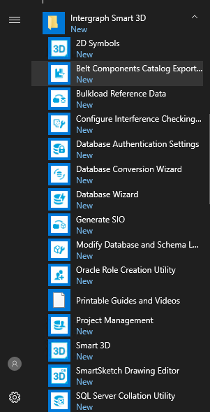
Project Setup: Familiarize with the software
Notes:
Verify what is installed if everything is selected
68

Slide 69
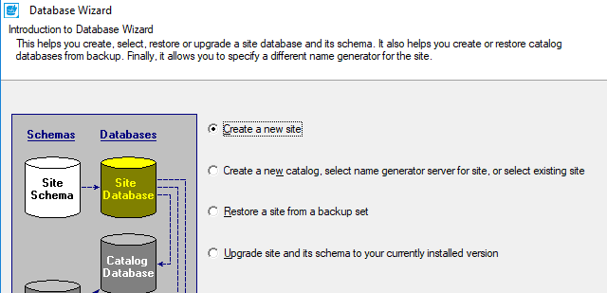
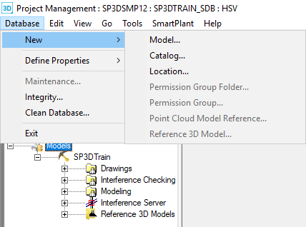
Project Setup: Database creation
Site and Catalog database creation
Database Wizard
Model creation
Project Management

Slide 70
Project Setup: Create a model from scratch
Site
Database Wizard AppRepos.dat/dmp
Site Schema
Catalog Project Management AppRepos.dat/dmp
Database Wizard CatalogDB.dat/dmp
Catalog Schema
Model
Reports Project Management
Reports Schema

Slide 71
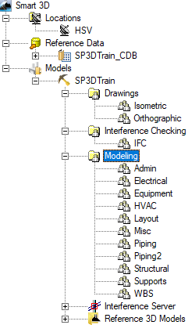
Project Setup: Permissions hierarchy
Model/Catalog root
Top level item in the hierarchy
Permission Group Folder
A set used to organize permission groups
Permission Group
Portion of model/catalog over which various people have various levels of access and responsibility

Slide 72
Project Setup: Permissions hierarchy
This hierarchy is seen only in Project Management
Can have unlimited number of levels of folders
Cannot have permission groups and permission group folders at the same level
Permission Groups are the last leaf in a branch
Copy/Paste permission groups available

Slide 73
Project Setup: Sample Permission Objects hierarchy

Slide 74
Project Setup: Modify Permission Objects hierarchy
Rename command
Folders cannot be deleted if there are Permission Groups under them
Permission Groups containing objects cannot be deleted
Copy/Paste of Permission Groups and Folders copies just the Permission Objects, not model items contained within. Name has to be unique within container (catalog or model).
Move command allow to relocate Permission Objects within container

Slide 75
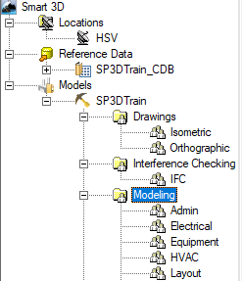
Project Setup: Root vs Permission Group assignment
Permissions can be granted for Windows Security Object (Groups and/or Users) at the Model/Catalog Root and Permission Group level
Permissions granted at Model/Catalog Root level allow access to modify permissions hierarchy within the model and perform various administrative tasks.
Permissions granted at Permission Group level affect access to objects within that permission group. These are used for general modeling purposes.

Slide 76
Project Setup: Association concept
When objects are placed, they will be automatically assigned to a permission group.
Objects can be associated to systems belonging to permission group where user has access
Objects can only be modified or deleted if user has access to permission group assigned to the object.
You can associate objects to those Work Breakdown Structure (WBS) items to which you have access based on the permission group they belong to.

Slide 77
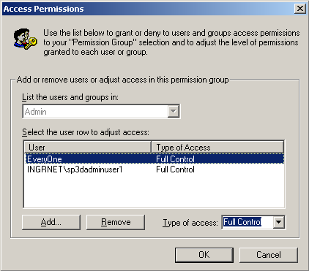
Project Setup: Permission access levels
Read = view objects
Write = create/modify/delete objects
Full Control = create/modify/delete + approve or reject objects

Slide 78
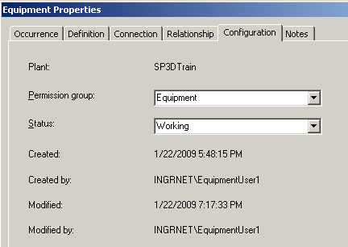
Project Setup: Object status
Working
Initial status of all objects; Objects can be edited/deleted while in this status
In Review
Object is in read-only mode and waiting for approval/rejection
Rejected
If an object is found to be incorrect, reviewer can send object to this status
Approved
If an object is found to be correct, reviewer can send object to this status

Slide 79
Project Setup: Status change based on permissions
Read
can’t change status
Write
can change from Working to InReview
can change from InReview to Working
can change from Rejected to Working
Full Control
can change from any status to any status

Slide 80
Project Setup: Permissions logical model
 | View | Create/Modify/ Delete | Send to review/ bring back | Approve/ reject
Read | √
Write | √ | √ | √
Full Control | √ | √ | √ | √

Slide 81
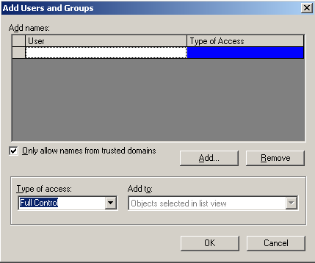
Project Setup: Add users to permission groups

Slide 82
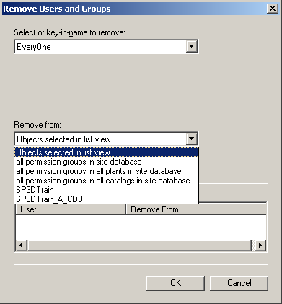
Project Setup: Remove users from permission groups
Select the users to be removed
Pick the places they need to be removed from

Slide 83
Project Setup: Access Permissions for SQL
Administrator
Sysadmin & Public (Server Roles)
No user mapping
Designers
Public (Server Roles)
User Mapping: db_datareader, db_datawriter & mapping to all 7 Smart 3D databases for a project. The users will also need Execute permission to each database.

Slide 84
Project Setup: Access Permissions for Oracle
Scripts delivered with Smart 3D Reference Data are located at [Product Folder]\ProjectMgmt\Tools\OracleScriptsToInitDB.
Scripts need to run in this order:
Create Roles for Smart 3D Users
SP3DUser_ROLES.SQL
SP3DProjectAdministrator_ROLES.SQL
Create Users for Smart 3D
SP3DUser.SQL (for Oracle) or
Linux_SP3DUser.SQL (for Linux)
Create Administrative Users
SP3DProjectAdministrator.SQL (for Oracle) or
Linux_SP3DProjectAdministrator.SQL (for Linux)

Slide 85
Project Setup: Minimum Access Privileges for Oracle
These script files create the necessary schemas, users, and roles that are used to run the software on Oracle with minimum access privileges
Scripts delivered with Smart 3D Reference Data are located at [Product Folder]\3DRefData\Tools\OracleScriptsToInitDB\MinimumAccessPrivileges
Scripts need to run in this order:
Create Roles for Smart 3D Users
SP3DUser_ROLES.SQL
SP3DProjectAdministrator_ROLES.SQL
Create Users for Smart 3D
SP3DUser.SQL (for Oracle) or
Linux_SP3DUser.SQL (for Linux)
Create Administrative Users
SP3DProjectAdministrator.SQL (for Oracle) or
Linux_SP3DProjectAdministrator.SQL (for Linux)

Slide 86
Database User Authentication: Why Support It?
Concern that OS authenticated users could connect outside of S3D with standard database tools (SQLPLUS, SQLCMD, SSMS) and cause damage. Other PPM products support DB user authentication.
A unified solution for S3D connecting to Oracle on Linux.
First implementation was relying on Oracle Wallet.
OS authentication does not allow connection to a database from a not trusted domain.
DB user authentication resolves the connection to database but Symbol share access problem remains.

Slide 87
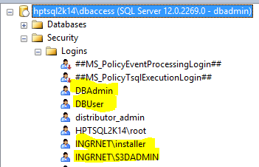
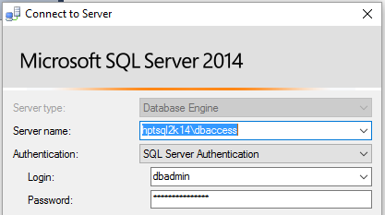
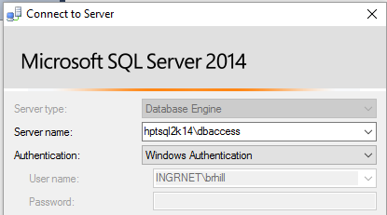
Database User Authentication
Database logins are accounts created in the database management system (i.e. SSMS). These accounts are separate from the login account you use to connect to the operating system
To open a connection to the database, a windows user has to type the user name and password every time.

Slide 88
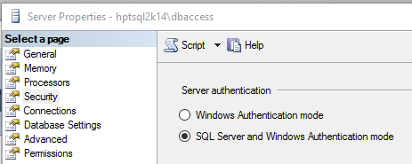
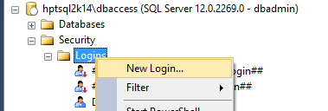
Database user login on SQL server
Make SQL server use mixed mode authentication (it is NOT set by default) using SQL server management studio “Server/Properties” page.
Create a database user login
Grant permission to that user on each database. Required roles for S3d standard user are:
public,
db_datareader,
db_datawriter
User must also have “Execute” (any stored procedure) permission on each database.

Slide 89
Database user login on Oracle
Look for scripts under [INSTALLDIR]\ProjectMgmt\Tools\OracleScriptsToInitDB
For a standard user, open the script SP3DUser.sql
replace “DOMAIN\USERNAME” with “TheUserName” (not case sensitive).
Replace IDENTIFIED EXTERNALLY with IDENTIFIED BY [TheUserPassword]
Example:
DROP USER S3dStandardUser CASCADE;
CREATE USER S3dStandardUser PROFILE DEFAULT IDENTIFIED BY S3dUserPassword
DEFAULT
TABLESPACE USERS TEMPORARY
TABLESPACE TEMP ACCOUNT UNLOCK;
GRANT UNLIMITED TABLESPACE TO S3dStandardUser;
GRANT SP3DUSER TO S3dStandardUser;
COMMIT;

Slide 90
Database authentication and S3D user Access control
Database User or OS authentication are not impacting S3D user access control.
S3D Permission groups are NOT based on database users.
Permission group access are based on OS user logged on the workstation.
For an S3D object, “user creator” or “last user modifier” are the id of OS user logged on the workstation.
On S3D V2014R1 or earlier, those columns were based on the database user login.
To support Oracle Linux, a CR was implemented early on S3D V2016 to be based on user logged on the workstation.

Slide 91
How S3D decides to use OS or DB authentication
S3d client connecting to the database.
Read in registry location of file containing DB user info.
Use OS authentication.
Not found?
Read from file:
ServerName
DBuserName
password (encrypted)
Open the connection.

Slide 92
Database Admin Setup for Database User Authentication
The database administrator creates a database user login.
That database user login is granted permission on the databases for a model database.
Site,Site_Schema,Catalog,Catalog_Schema,Model,Report,Report_Schema
The database administrator creates a DBAuthentication.ini file on a shared folder.
DBA uses [InstallDir]\ProjectMgmt\Tools\bin\ConfigureDBLoginFile.exe to create that file.
<DBAuthentication.ini> contains: ServerName, databaseUserName, encryptedDatabasePassword.
Multiple servers can be in DBAuthentication.ini.
A server name must be unique on a DBAuthentication.ini.

Slide 93
Setup and Administration Lab
Labs 2 - 4

Slide 94
Backup and Restore

Slide 95
Backup and Restore: Overview
Backup
Project Management Backup
Manual backup of the Shared Content folder
Restore options
Restore one or more model databases from backup
Restore model for selective recovery of model objects
Restore model as a copy

Slide 96

Backup and Restore: Project Management Backup
Model, Catalog and Site databases are backed up, reports databases are excluded.
A backup configuration file (bcf) containing information about the backup set is created in the location specified for the backup
Backup files will be saved to database server by default
Backups may be saved to a network location, additional configurations are required for this

Slide 97
Backup and Restore: Project Management Backup
There are no individual files to be backed up – only complete databases
To complete the backup set, user needs to manually backup the Shared Content folder for the model
Multi-model backup available
User running the backup as well as account used as logon for Oracle Windows NT Service need to have write permissions on the folder under which backup files will be created.

Slide 98
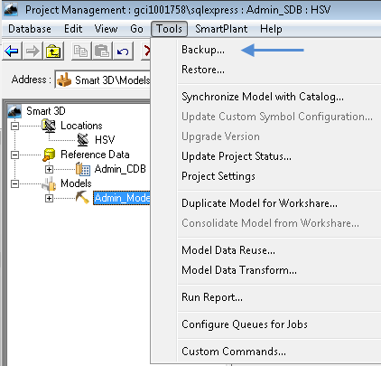
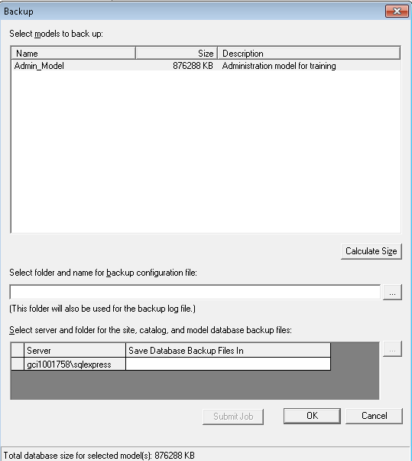
Backup and Restore: Project Management Backup

Slide 99
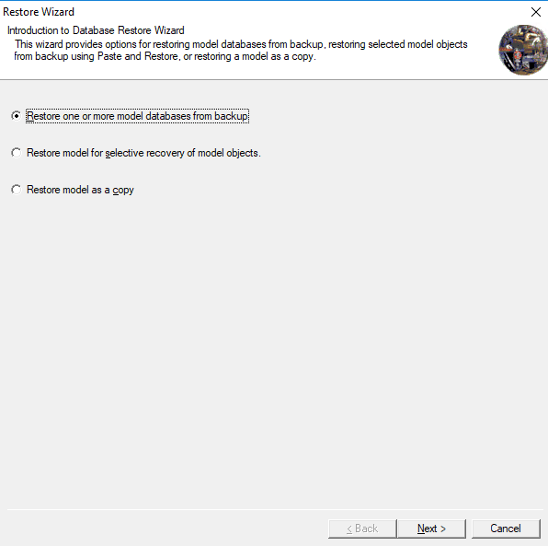
Backup and Restore: Restore options

Slide 100
Backup and Restore: Restore one or more model databases from backup
Restores previously backed up models overwriting the existing one.
You can only restore a complete model (no partial restore)
Catalog can be overwritten or not depending on user selection to prompts
Items that were manually backed up (Shared Content folder) need to be manually restored as well

Slide 101
Backup and Restore: Restore model for selective recovery of model objects
Restores a model from a previous backup, without overwriting the existing model.
Allows for selective recovery of objects from previous versions of the same model without losing object identity or relationships
The restored project will exist in the Site database in parallel to the current project and would share the same catalog.

Slide 102
Backup and Restore: Restore model as a copy
Allows the restore of models that were backed up from a different site database.
Allows to create a replica but independent model from the production model backup (test models).
Ability to change the name of the model and the restored model and catalog databases.
When the selected model to restore is registered with SmartPlant Foundation, the registration is removed from the copy during the restore.

Slide 103
Backup and Restore: Off-site Restore
May be used to restore entire project on a new location, it can be due to a change in database servers, or to restore a backup received from a third party company.
Using database wizard, restore site from backup set
Using project management, restore model from backup (this brings in catalog associated with the model)
Regenerate report databases
Manually copy all the Shared Content files and outputs to the remote site
Custom symbol dlls need to be registered on each client workstation at the remote site if required

Slide 104
Setup and Administration Lab
Lab 5 – 8

Slide 105
Project Management: Delete a Model
Full Control permission at the root level.
Option to drop or leave the physical database files in place.
For models in Oracle, the software may not delete all of the associated database objects. To delete schema information after deleting an Oracle model, you must use the Oracle Database Tools Wizard for Smart 3D located at [Product Directory]\ProjectMgmt\Tools\bin\SP3DOracleDBToolsWizard.exe.
Notes:
105

Slide 106
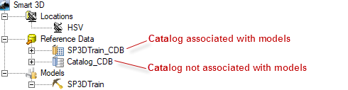
Project Management: Delete a Catalog
Catalogs can only be deleted if they are not associated with any model.
In Oracle servers, Catalog must also be deleted using the Oracle Database Tools Wizard for Smart 3D
Notes:
106

Slide 107



Project Management: Hierarchy Icons
Top level of the hierarchy
Reference data
Catalog associated with a model
Catalog associated with a model. Missing database
Catalog associated with a model. Needs to be upgraded
Catalog not associated with a model
Catalog not associated with a model. Missing database
Catalog not associated with a model. Needs to be upgraded
Model
Model missing database
Model needs to be upgraded
Permission group folder
Permission group
Notes:
107

Slide 108
Project Management: New Catalog Command
Create a new empty catalog or create a catalog from a template.
Default permission groups and access rules are created.
In a Global Workshare configuration, the Database > New > Catalog command is available at the Host location, but not at the Satellite locations.
Every catalog must be associated to a Shared Content folder
Notes:
108

Slide 109
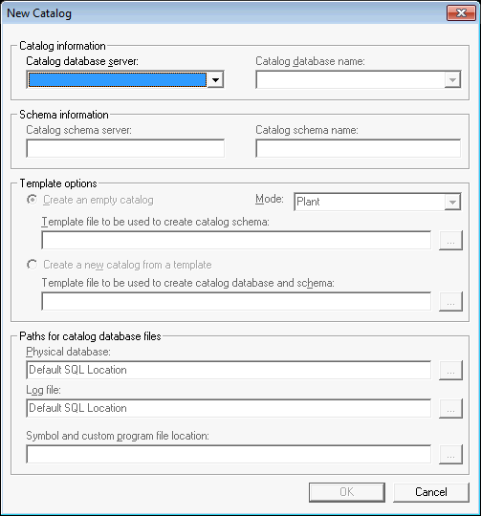
Project Management: New Catalog Command
Notes:
109

Slide 110
Custom Properties: Define Property Schema
Additional properties for models, permission group folders and permission groups can be added
Properties can be viewed in project management environment but are also reportable
Property information for models is stored in the site database to which they belong
Property information for permission folders and permission groups is stored in the model to which they belong
Notes:
110

Slide 111
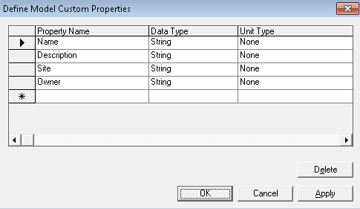
Custom Properties: Define model property
Notes:
111

Slide 112
Setup and Administration Lab
Lab 9 – 11

Slide 113
Model Organization (Systems)

Slide 114
Systems and Specs: Contents
System hierarchy
Create and modify Systems hierarchy
Assign allowed specifications

Slide 115
Systems and Specs: Systems overview
A system is a container that group objects logically
Systems have other systems as children creating a hierarchy with unlimited levels
Subsystems can belong to a different permission group from their parent
Many different types of systems are supplied (discipline specific and generic)
Every object must belong to a system
Different types of objects can be associated with different system types

Slide 116
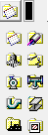
Systems and Specs: System types
Generic system
HVAC system
Equipment system
Pipeline system
Unit system
Conduit system
Electrical system
Piping system
Structural system
Area system

Slide 117
Systems and Specs: Create and modify Systems hierarchy
Create new System commands
Copy and paste of Systems
Importing from excel

Slide 118
Systems and Specs: Create new System commands
Creates a system as a child of the currently selected system
Currently active name rule for the system type being created is used to generate the name
If currently active name rule is ‘User-defined’, you can enter the name during creation
Systems and specifications task – Dedicated function

Slide 119
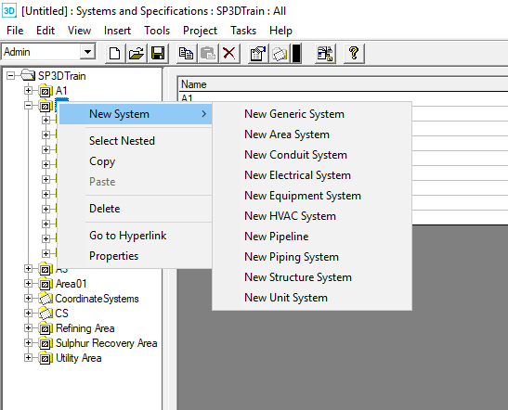
Systems and Specs: Create new System commands
Systems can be created from workspace explorer hierarchy.
Systems and specifications task - Contextual menu

Slide 120
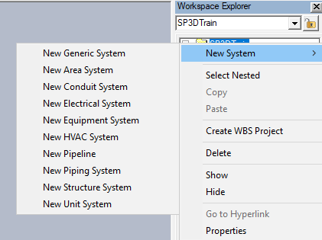
Systems and Specs: Create new System commands
Systems can be created from workspace explorer hierarchy.
Graphical tasks

Slide 121
Systems and Specs: Copy and paste of Systems
Systems can be copied in Systems and Specification task or in the Workspace Explorer
To select the entire hierarchy under a system, right-click the system then choose option “select nested”
Paste the hierarchy where desired (paste dialog box may appear)
You can copy and paste system hierarchies between two models that exists in the same site database

Slide 122
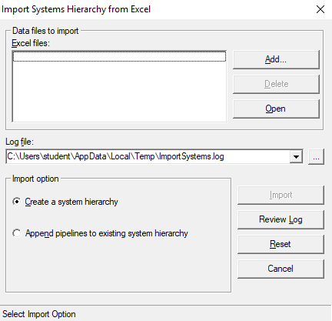
Systems and Specs: Importing from excel
You can create an entire systems hierarchy or add pipelines to an existing hierarchy using an Excel workbook
Allowed specifications for pipelines can also be set in the workbook.
If specifications are allowed to pipelines in the workbook, these pipelines will not automatically inherit specifications allowed at parent levels including the root.

Slide 123
Systems and Specs: Editing Systems
Deleting Systems
Renaming Systems
User defined
Default naming rule
Moving Systems
Move using system’s properties page
Move using drag and drop in the Systems and Specification task

Slide 124
Systems and Specs: Allow specifications
Specifications limit part selection and placement based on rules.
By default, specifications are defined in the Catalog and must first be allowed to the Model
All systems inherit the specifications allowed at the Model root node, unless specifications were allowed from import command.
Each system must be allowed at least one specification

Slide 125
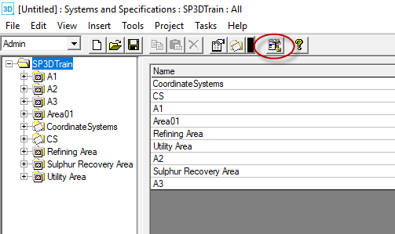
Systems and Specs: Define allowed specifications
Systems and Specifications task

Slide 126
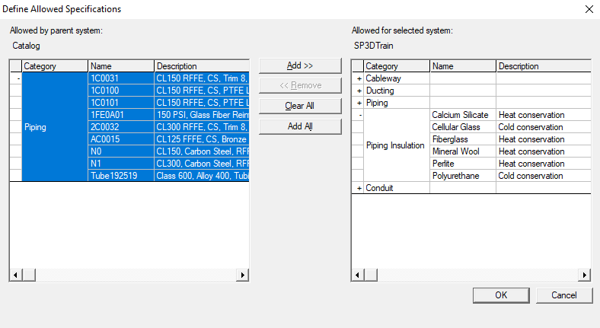
Systems and Specs: Define allowed specifications
Whole categories can be selected with a single click
Notes:
126

Slide 127
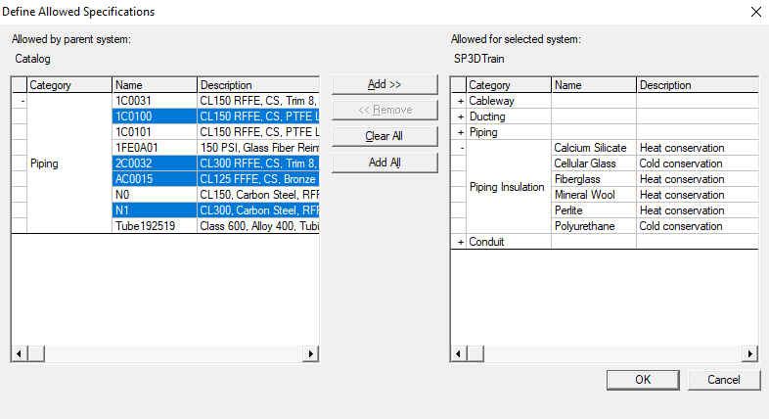
Systems and Specs: Define allowed specifications
Multi-selection of specifications and/or categories
Notes:
127

Slide 128
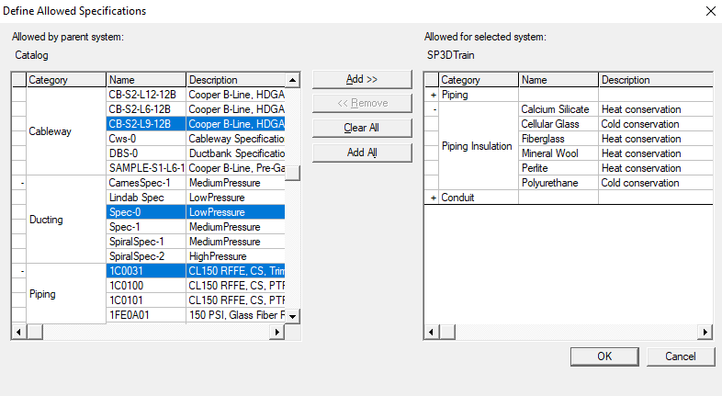
Systems and Specs: Define allowed specifications
Multi-select of specifications from different categories
Notes:
128

Slide 129
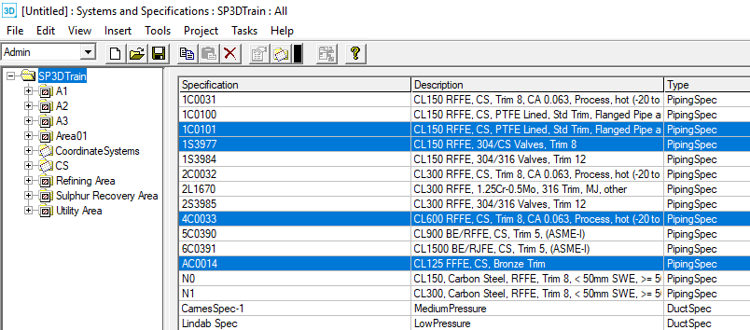
Systems and Specs: Define allowed specifications
Easier method to remove allowable specifications from a system
Switch to the specifications tab while browsing the systems hierarchy
Multi-select specifications and press delete button from ribbon bar
Notes:
129
In the systems and specs environment, rename command should be available on the right-click menu in the tree view and on the Edit menu.
Allow multi-select of systems in the tree view for copy/paste & delete

Slide 130
Setup and Administration Lab
Lab 12 - 15
Notes:
130

Slide 131
Common Applications

Slide 132
Optimization for Roles

Slide 133
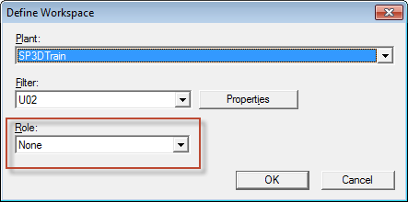
Optimization for Roles
Used to refine Workspace definition filter
Roles are defined in delivered OptimizationforRole.xml
Location: \\Server\SharedContent\Xml
Each role is defined with a set of disciplines and subclass object types

Slide 134
Default Color Configuration

Slide 135
Default Color Configuration – The basics
Project Management command
Import
Export
Configure Default Colors
Apply Default Colors

Slide 136
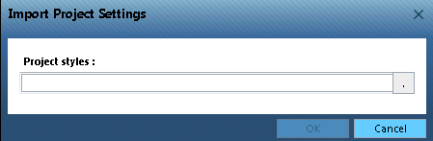
Default Color Configuration
Import
Aids in importing a set of “Default Style” rules into a model database
Used for porting rules from one model to another
Intergraph Defaults are available in SharedContent/XML folder

Slide 137
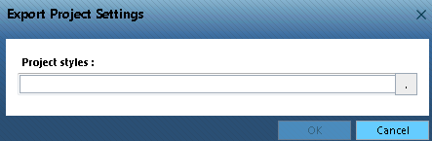
Default Color Configuration
Export
Aids in exporting the “Default Style” rules from a model to be ported to another model

Slide 138
Default Color Configuration
Configure Default Colors
Styles (colors) are applied per object type
Rules define the style applied to object types
Granular level of coloring based on object properties
Color by Role makes it possible to define different colors for same object type based on role (workspace simplification role) of the person using it.

Slide 139
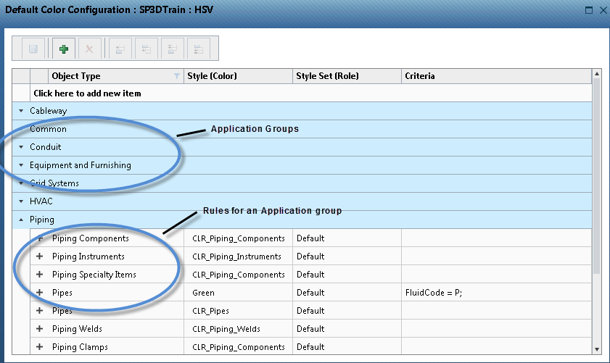
Default Color Configuration
Configure Default Colors

Slide 140

Default Color Configuration
Configure Default Colors
Create a rule

Slide 141

Default Color Configuration
Configure Default Colors
Create a rule

Slide 142

Default Color Configuration
Configure Default Colors
Define criteria

Slide 143

Default Color Configuration
Apply Default Colors
New Default Color Rules are applied to new or modified objects automatically
Apply Default Colors to change appearance of existing objects in the model
This is a time consuming process and shall be sparsely used

Slide 144
Default Color Configuration
Considerations
New rules are automatically applied only to new or modified objects
Colors by default symbology rules are applied only to the simple physical aspect
Default colors may be used for colors such as object type or fluid code which are not expected to change through the life of the project, SSRs should be used for setting colors based on properties which change as project progresses such as approval status
Default colors are applied by default to insulation (translucent white), maintenance and operation aspects (translucent red) but SSRs may be used to apply other colors to aspects
Avoid testing on production models, time to apply default colors can impact testing time - use a model which has one occurrence of each object type for ease of testing

Slide 145
Default Color Configuration
Considerations
Colors are not consistently applied on session files created prior to applying changes. New session files are recommended after making new rules.
When using default colors by Role, the colors will not be dynamically updated for saved sessions. New session files need to be created.
Colors will not change automatically to Intergraph's new color scheme after a version upgrade of existing models before V2014 R1, however new models created with 2018 will automatically apply the DefaultSymbologyRules.xml file from SharedContent/Xml folder.
Coloring equipment by classification will take care of equipment, components and shapes but for nozzles, edges available on Smart Support may need to be used to select nozzles with specific classification and apply default colors to them.

Slide 146
Default Color Configuration
Considerations
Colors with the ‘Default’ role are automatically applied to SPR session exported from the S3D session, further overrides may be applied using property page for 3D Model Data or ReportSettings.txt for SPR Direct

Slide 147
Setup and Administration Lab
Lab 16 - 18
Notes:
147

Slide 148
Model Data Reuse (MDR)
Notes:
148

Slide 149
Model Data Reuse: Introduction
Model Data Reuse (MDR) is a way to copy large amounts of 3D model data in a robust, scalable and intelligent way
MDR supplements the current copy/paste process – the existing process remains in place for smaller sets of data

Slide 150

Model Data Reuse: Results

Slide 151
Model Data Reuse: Advantages
MDR runs from Project Management environment as a wizard
Interaction with objects is not required
Does not require objects to be loaded into memory
process is scalable and can copy much larger sets of data
Software breaks down copy set into multiple transactions
Process is robust and can tolerate a failure; it will continue to copy the rest of the remaining objects

Slide 152
Model Data Reuse: Advantages
Software determines the sequence in which to copy objects
Permission group mapping to existing or default permission group
Transformation can be chosen using coordinate systems
Very good logging of process (including failures)
Copy of model objects between models is supported
Target locations in different servers is supported
Re-startable process

Slide 153
Model Data Reuse: Recommended Practices
In Plant models, copying an entire unit system or area system. A unit or area typically includes many structural members, slabs, walls, equipment, foundations, pipe runs, ducts, cable trays, conduits, and hangers.
In Marine models, copying major sections of marine structure and outfitting. The sections may be organized into assemblies or blocks.
In Material Handling models, copying an entire conveyor system, including belts, equipment, modules, chutes, trusses, and trestles.

Slide 154

Model Data Reuse
MDR command exists only in Project Management

Slide 155
Model Data Reuse Workflow
Restart an Operation
Select source objects based on systems
Begin Model Data Reuse
Select disciplines to be copied (optionally WBS, Assemblies, Volume, Drawings)
Start a New Operation
Select source objects based on filters
Select destination model and system (optionally map PGs)
Select a transformation
Confirm copy and review results

Slide 156

Model Data Reuse
The Model Data Reuse command invokes a wizard which allows you to complete the copy operation

Slide 157
Model Data Reuse: Restart Operation
If the restart operation is selected then the user gets a list of all operations and their status.
Possible statuses:
Stopped: Process terminated in an orderly way (User clicked stop on the progress button).
Incomplete: Process terminated abnormally (Hardware/Software failure on client machine).
In Progress: Operation is restarted on a different client machine.
Completed: Operation completed successfully.

Slide 158
Setup and Administration Lab
Lab 19 - 21
Notes:
158

Slide 159
Model Data Transform
Model Data Transform (MDT) command allows you to move and/or rotate a large portion of the design objects in a model from one location in the model to another.
The processing is done in two phases:
The first phase, the objects in each partition are disconnected from the surrounding objects.
The second phase, the disconnected objects in each partition are transformed to their new location.
The set of objects can include read-only objects. If a read-only object prevents disconnection or transformation, MDT allows you to correct the situation and restart the operation.

Slide 160
Model Data Transform : Best Practices
Create a backup
Disconnect objects at the boundary
Have write permission
Avoid concurrent editing
Model Data Reuse (MDR) and Model Data Transform (MDT) workflow using delete optional

Slide 161

Model Data Transform : Best Practices

Slide 162
Setup and Administration Lab
Lab 22
Notes:
162

Slide 163
Synchronization

Slide 164
Synchronize Model with Catalog
Used to propagate changes from the catalog to the model (including property, specification, and symbol changes)
CDB
MDB

Slide 165
Synchronize Model with Catalog
The model database is updated to include the following changes:
Modifications to properties that have been bulkloaded into the catalog.
Modifications to name rules.
Parts that have been deleted from the Catalog are added to the To Do List.
Does not automatically synchronize Reference 3D models. You can choose to synchronize the Smart 3D model with the Reference 3D model when you update the Reference 3D project.

Slide 166
Synchronize Model with Catalog
Actions performed by the Synchronization command will depend on the level of access of the user running the command from Project Management:
User with write access to model objects:
Extended execution time
Model objects will be updated automatically with no user interaction
User with read access to model objects:
Reduced execution time
Objects will not be updated automatically

Slide 167

Synchronize Model with Catalog

Slide 168

Synchronize Model with Catalog
To list all objects that have been flagged for interactive update in the model workspace, run Diagnostic Synch Workspace Report

Slide 169
Database Maintenance Command

Slide 170

Database Maintenance Command
Provides a tool to purge temporary data that may cause performance issues.

Slide 171
Database Maintenance Command
Delete temporary symbol variations (flavors) in database
These are temporary symbol variations that the software used during creation or placement of certain symbols.
Delete records of objects that users have deleted from model
Rebuild selected indexes
Reorganize selected indexes

Slide 172
Setup and Administration Lab
Lab 23 - 25
Notes:
172

Slide 173
Database Integrity

Slide 174
Database Integrity: Overview
Database integrity problems are issues of the modeled objects that can in some circumstances prevent modeling activities or impact the accuracy of deliverables such as drawings or reports.
A typical example of a database integrity issue is an object that exists without a mandatory relation to another object in the model.

Slide 175
Database Integrity: Overview
Important
These errors are not expected. However, in the event that they occur, you can correct them by perfoming the database integrity workflow in which objects will be addressed
We strongly recommend that you check the databases from time to time and promptly report any unknown problems to Intergraph.
If you receive a database integrity error that is not listed in documentation, contact Intergraph Process, Power & Marine Support.

Slide 176
Database Integrity: Workflow
The workflow to address database integrity issues have three overall steps:
1. Execute database integrity from Project Management.
2. Generate a report to review issues found.
3. Run Clean database command to address problems.

Slide 177

Database Integrity: Execute Database Integrity
Execute database integrity from Project Management
Check Database Integrity runs directly on a database (Site, Catalog, or Model), and creates records for the objects that need to be cleaned. Once the database has been scanned for errors, you can generate a report to review the errors that the Check Database Integrity command generated.
You can run this command multiple times:
To check the database for objects with integrity problems
To confirm that objects have been deleted or cleaned (second pass)

Slide 178

Database Integrity: Generate reports
Generate a report to review issues found
The software includes various report templates intended for diagnosing database integrity issues. You can run these report templates by opening a session in the software and clicking Run Report command from the Tools menu. Report templates are located in the Catalog Reports tab then under Report > Types of Reports > Diagnostics node. Select any of the four following reports:
Diagnostic clean database issues
Diagnostic clean database issues grouped by problem description
Diagnostic clean database issues grouped by status
Diagnostic clean database issues with column filters

Slide 179

Database Integrity: Generate reports
DataStore Displays whether the problem exists in the model or Catalog database.
Problem Description Provides a brief explanation of the issue. Use it to search more details in DBIntegrity.pdf guide
Status Determines if the issue is new, existing or resolved
Severity Fatal, Crucial, High, or Normal
Action to Take Describes what to do to fix the problem. Possible values include No Action, To Be Removed or To Be Repaired.
If the action is To Be Repaired, you should run Clean Database custom command.

Slide 180
Database Integrity: Run clean database command
Run Clean database command to address problems.
Consult latest DBIntegrity.pdf document for the correct workflow to fix the problem.
Most workflows involve use of the Clean Database custom command
Action to take = To Be Repaired

Slide 181
Database Integrity: Run clean database command
Clean Database Custom Command
SP3DCleanDatabaseCmd.CCheckObj

Slide 182
Setup and Administration Lab
Lab 25
Notes:
182

Slide 183
Error Log and Memory Monitor

Slide 184
Error Log & Memory Monitor
Error Log
On by default, but needs to be set for persistence (cleared when session closes)
.Activate using …\Core\Tools\Administrator\Bin\ErrorLogEnable.exe
4 Severity levels
Time-based log file names
Error log created per session or instance
Memory monitor
Reports memory usage for all active Smart 3D sessions
Different reporting states (Warning, Critical)
Notes:
184

Slide 185

Error Log & Memory Monitor

Slide 186


Error Log & Memory Monitor

Slide 187
Troubleshooting Assistant
Consolidates error logging across all S3D tasks
Includes general S3D error logging (S3D error log, Assoc log)
Easy-to-use GUI
Ability to collect relevant files in zipped folder
Links to troubleshooting reference guide and Smart Support website
Download from Smart Support (smartsupport.intergraph.com)
View Downloads > Smart 3D > Freeware Tools and Utilities > Uncertified Tools

Slide 188

Troubleshooting Assistant

Slide 189
Setup and Administration Lab
Lab 26

Slide 190
Interference Checking (IFC)

Slide 191
Interference Checking Detection (IFC): Overview
Smart 3D provides two methods for IFC operation:
Server-based Interference checking (database detection).
- Runs on a separate server as a Windows NT Service
- Looks for all interferences in the model
Interactive interference checking (local detection).
- Helps the designer in real time
- Results are scoped to objects in a session (what you see in your workspace)

Slide 192
IFC: Characteristics
Database Detect | Local Detect
Runs continuously (System Administrator choice) | Works only within the current session
Dedicated server minimizes impact on users and improves performance | Provides immediate graphical feedback (works immediately after commit)
Creates persistent interferences that are stored in the model database | Creates temporary interference markers in a user session
Based on administrator settings (controlled by permission groups) | Based on individual user settings
Provides feed back on how much has been checked | Checks only created and modified items

Slide 193

IFC: Visual differences
Any interference detected by the server based detection method appear as a sphere
Interferences detected by local based detection method appear as a box

Slide 194



IFC: Visual differences
Hard clash
Soft clash
Clearance clash

Slide 195
IFC: Aspects
Aspect: Geometric area or space related to an object, such as its physical shape or the space required around the object.
Aspects are defined when a part class is created for the reference data.
Aspects can represent clearances for safety or maintenance areas.

Slide 196

IFC: Aspects
Simple Physical
Detailed Physical
Insulation
Operation
Maintenance
Reference Geometry
Centerline

Slide 197

IFC: Configuration

Slide 198
IFC: Configuration – checking priority
Three types of checking priorities (based on object aspects):
Required - Produces a Hard type of clash
Optional - Produces a Soft type of clash
Not Checked - Elements currently displayed in this aspect will not be checked for interferences

Slide 199
IFC: Configuration – comparison criteria
IFC can process the following combination of objects based on their checking priorities:
Required – Required (Hard – Hard)
Required – Optional (Hard – Soft)
Optional – Optional (Soft – Soft)

Slide 200
IFC: Configuration – Clearance rule
Clearance rules define the minimum distance between any two objects

Slide 201



IFC: Configuration – Clearance rule

Slide 202
IFC: Configuration – Permission group
All markers representing clashes or clearances will be assigned to a permission group

Slide 203
IFC: Local detection
IFC local detection is available from all tasks in a session (Tools → Check Interference)
Very simple and intuitive GUI
Ribbon bar includes:
Settings
Visualization
Review & approval commands

Slide 204
IFC: Local detection
Local detection toolbar
Settings
Hide Interferences
Fit on Interferences
Close Toolbar
Show Interf.
Refresh R3D Interferences
List view

Slide 205

IFC: Local detection

Slide 206

IFC: Local detection – List view
Show interferences currently displayed in the workspace
Updates automatically
Sort by any column

Slide 207
IFC: Database detection
Verify permission requirements (one time)
Configure interference service properties
Start interference detection Windows NT Service
Create IFC permission group folder and permission group (one time)
Start database interference detection process

Slide 208
IFC: Database detection
Verify permission requirements (one time)
For the interference database detection process to run correctly, user setting up IFC must meet permission requirements according to the following guidelines:
Smart 3D user permissions:
Full Control access at the root of the model is required to start/stop IFC Process
Write access or higher to the designated IFC permission group
IFC Windows NT Service login permissions:
Identity for the service must be a domain account that has Write or higher level of access to the designated permission group for IFC. If possible use login with a password not required to change as often as a corporate user account.
User needs at least Read access on SharedContent folder
User needs database access and permissions as a regular user to SQL or Oracle

Slide 209


IFC: Database detection
Configure interference service properties

Slide 210


IFC: Database detection
Start interference detection Windows Service

Slide 211

IFC: Database detection
Create IFC permission group folder and permission group (one time)

Slide 212
IFC: Database detection
Start database interference detection process

Slide 213

IFC: Database detect
Modifications to Database Interference properties
If any change to settings on IFC properties form is to be done at any time during the life of the project, all objects in the model need to be reprocessed from the beginning (0% to 100%).
Notes:
213

Slide 214
IFC: Codeless IFC
Codeless IFC is an Interference rule which is customizable using an XML configuration file, instead of code changes.
This functionality allows, using simple text based rules, to:
Ignore objects for clash checking
Ignore clashes between objects
Set clash properties
With S3D 2016, it is delivered with the product.

Slide 215
Setup and Administration Lab
Lab 27

Slide 216
Point Cloud Model Reference

Slide 217
Point Cloud Reference

Slide 218
Point Cloud Reference
Smart 3D provides vendor-neutral point cloud data integration within the Model modeling software environment.
Saves redrawing an object, while still being able to add to it or build on top of it.
Point cloud models can be registered (attached) at the satellite location.
You can now move or rotate the attached point cloud in Project Management.

Slide 219
Point Cloud Reference: Supported point cloud vendors
Leica Geosystems
Quantapoint
Trimble
Z+F UK

Slide 220
Point cloud reference: Possible actions
Accessing Point Cloud (Accessories menu, filters)
Selecting a Data Point
Measuring
Interference Checking (IFC)

Slide 221

Point cloud reference: Attach Point Cloud to model
Right click the model in Project Management
Select New Point Cloud Model Reference.
Select a vendor from the Select Point Cloud vendor to use list.

Slide 222
Point cloud reference: Detach Point Cloud from model
Right click the model in Project Management
Select New Point Cloud Model Reference
Select None from the list of vendors to use

Slide 223
Reference 3D (R3D)

Slide 224
Reference 3D: Overview
Reference 3D (R3D) functionality facilitates the attachment of external 3D data as a reference model.
Such external data might have been published from another Smart 3D model or from a third-party model such as PDMS.
The data from external models is expected as a set of graphic (.zvf) and data (.xml or .drv) files.

Slide 225



Reference 3D: Concept
.ZVF
.XML

Slide 226
Reference 3D: Functionality
With Reference 3D you can do the following:
Attach and orient (position, rotate, and scale) the reference model relative to the active model so that you can view the R3D data graphically and model against it.
Control (add) R3D objects, hierarchy, and properties with user-defined schema and mapping files to extend the delivered R3D schema.
Inspect the R3D model objects' properties and view their names through ToolTips.
Use a powerful Smart 3D filtering mechanism on R3D Objects to filter objects from Reference 3D Models based on their type—regardless of the authoring tool used for creation (SP3D, SM3D PDMS, and so on).
Extract simple General Arrangement drawings showing relative positioning of objects from R3D models, with limited annotation.

Slide 227

Reference 3D: Transformation overview
N
150 m
100 m
O
E
90°
200 m
-125 m

Slide 228
Reference 3D: Attaching Smart3D Models
.ZVF
.XML
Publish Data
Attach as R3D Model
Source Model
Target Model

Slide 229



Reference 3D: Attaching PDMS Models
.RVM
.ATT
Export RVM
Translate Data
PDMS
.ZVF
.DRV
Attach as R3D Model
Smart 3D

Slide 230

Reference 3D: Filters
R3D includes a very powerful filtering mechanism that allows you to filter objects from references based on their type, regardless of the authoring tool used for creation (Smart 3D, PDMS, and so on).

Slide 231
Reference 3D: Business cases
Some of the business cases provided by this functionality include:
Supporting disconnected workshare
Preserving intellectual property in joint venture projects
Allowing for better security in joint venture projects
Compatibility between datasets from different S3D versions
Bridging differences between Smart 3D datasets on disparate databases (Oracle vs SQL)
Ability to work with datasets from external tools such as PDMS, XMpLant
Support parallel design for increased productivity

Slide 232
Reference 3D: Business cases
Some of the business cases provided by this functionality include:
Supporting Disconnected Workshare
Since the data is published to files at the source location(s) and attached as a reference at the target location, live connection between the databases is not required.
Periodic publish and update of the R3D models would allow multiple partners to work on a joint venture product in a disconnected manner.

Slide 233




Reference 3D: Business cases – disconnected workshare
Publish
Update
Attach
Sub Contractor
(Source Model)
Prime Contractor
(Target Model)

Slide 234
Reference 3D: Business cases
Some of the business cases provided by this functionality include:
Supporting Parallel Design for Increased Productivity
If a project has many similar units, only one unit may be modeled and published. This published unit can then be attached multiple times with the required positioning.
Additional modeling such as civil work can be performed simultaneously
Model Data Reuse functionality can be used to actually replicate unit across to obtain real S3D objects

Slide 235
Setup and Administration Lab
Lab 28 - 31

Slide 236
Reference 3D: SPRDirect Output
Allows to publish Smart 3D reference objects (DGN/DWG, PDS) to Graphic (VUE) and label data (MDB2) files
Files can be opened in SmartPlant Review or using Reference 3D.
Easier and Faster way to get Smart 3D project to SPR where you can interactively review and analyze 3D model data.

Slide 237


Reference 3D: Attaching SPRDirect Data
.VUE
.MDB2
SPRDirect Output
Translate Data
.ZVF
.MDB2
Attach as R3D Model

Slide 238

Reference 3D: Convert to ZVF
ConvertToZVF.exe utility is delivered out of the box and can be found at the following location;
..\Core\Tools\Administrator\Bin\

Slide 239


Reference 3D: Create Folder Hierarchy
If there is folder hierarchy on disk below the root folder of the R3D attachment, this folder hierarchy is automatically reflected in the WSE without having to do anything extra in S3D
Hide and show command works at any level in this hierarchy in WSE to quickly hide and show the graphics in that branch

Slide 240


Reference 3D: Levels and Layers
The properties page of the R3D model, folder or file shows the levels or layers and display can be turned on or off using check boxes.
Surface style rules can be created based on Levels and Layers in the R3D model which can be exported to SP Review.
Filters can be defined based on Levels and Layers.
Surface style rules can be created based on these filters which can be exported to SP Review.

Slide 241
Setup and Administration Lab
Lab 32

Slide 242
Intergraph Batch Services

Slide 243
Batch Services
This functionality allows scheduling of regular, time consuming tasks through the Intergraph Batch Services application.
Database Integrity Command
Backup Command
Restore Command
Structural import
Structural export
Drawings and Reports update
Printing drawings
Updating multiple R3D models

Slide 244
Setup and Administration Lab
Lab 35 - 37

Slide 245
Database conversion (SQL ←→ ORACLE)

Slide 246
Database Conversion Wizard : Overview
Used to convert databases from SQL Oracle
Prerequisites:
- SQL and Oracle databases should be running.
- Client machine needs SQL server registered and TNSNames entry for Oracle instance.
- Non-replicated databases.

Slide 247

Database Conversion Wizard

Slide 248

Database Conversion Wizard

Slide 249
Schema Name Validator : Overview
The Schema Name Validator tool identifies names which are prone to fail due to Oracle 30 character limitation from site, catalog and model databases and dumps the data into an excel work book with type of data as work sheets.
This utility identifies part classes, custom interfaces, and custom interface attributes that violate the Oracle character limitation. This allows you to bulk load the data into an Oracle database, as long as the changes are updated in the bulkload data files.
This is particularly useful when converting MSSQL databases to Oracle databases.
This utility is delivered by default to the SchemaNameValidator.exe file in the <Product Folder>\Core\Container\Bin\Assemblies\Release\ folder.

Slide 250
Schema Name Validator
Impacts
You must update any custom code such as shared content or reports so that they use the truncated part class, custom interface, and attribute names.
You must update the changed names in the code for custom symbols, if they are used.
You must update all data files (such as Excel workbooks) so that they use the new names. The names in GUIDs sheets must be replaced to ensure that the GUID values associated with the old and new names are identical. You must update the GUID sheets to avoid errors in future bulk loads.
After Updating
Update all data files, reports, and shared content code with the truncated names.
Regenerate views on all of the model databases.
Run Synchronize model with catalog with the Regenerate views option selected on all of the projects. Regenerate the reports database for each model database.

Slide 251

Schema Name Validator

Slide 252
Adding User Defined Attribute To S3D Database

Slide 253

Adding User Defined Attribute to S3D Objects
A typical project requirement can be to have a common user attribute to S3D objects. This attribute needs to be bulkloaded into the S3D catalog.

Slide 254
Adding Approval Status In S3D

Slide 255

Adding Approval Status in S3D
Project administrators would like to add new approval reasons for S3D objects. These could be bulkloaded to the catalog using a codelist.

Slide 256
Setup and Administration Lab
Lab 38 - 39

Slide 257
Model Version Upgrade

Slide 258
Database Version Upgrade: Overview
Database upgrades are required whenever there is a major change of software version
Smart 3D 2016 supports upgrade from following versions:
- 2014
- 2014 R1
It is only possible to upgrade a model configuration using the same database type (Oracle to Oracle or SQL to SQL).

Slide 259
Database Version Upgrade : Prepare for the Upgrade
Backup all databases and symbols
Verify integrity of data
Verify/clean specifications
Synchronize model with catalog
Resolve To-Do list
Verify access to reference files
Run database integrity and clean corrupted elements
Final backup with old version
Prepare the workstation and servers for the upgrade. Make sure all previous versions of Smart 3D are uninstalled and install prerequisites for V2016.

Slide 260
Database Version Upgrade : Performing the Upgrade
Upgrade your files in the SharedContent share
Manage custom symbols, naming rules and report template files (if necessary)
Restore Site database and upgrade through Database Wizard.
Restore Catalog and Model databases and upgrade through Project Management
Synchronize the Model with the Catalog
Run database integrity and correct possible issues
Regenerate the Reports database
Upgrade Reference Data

Slide 261
Upgrade SharedContent Wizard
The Upgrade Shared Content wizard will copy your original 2014 or 2014 R1 SharedContent to a new location and then apply appropriate new files from the delivered 2016 SharedContent.
Located on Smart Support under: View Downloads > Smart 3D > Freeware Tools and Utilities > Certified Tools.
The upgrade to the SharedContent must be done BEFORE upgrading the databases to V2016.

Slide 262

Upgrade SharedContent Wizard

Slide 263

Upgrade SharedContent Wizard

Slide 264

Upgrade SharedContent Wizard

Slide 265

Upgrade SharedContent Wizard

Slide 266


Upgrade Version – Database Wizard
Upgrade the Site Database (after restoring)

Slide 267

Upgrade Version Command – Project Management

Slide 268

Upgrade Version Command – Project Management

Slide 269

Upgrade Version Command – Project Management

Slide 270

Upgrade Version Command – Project Management

Slide 271
Smart 3D Automation Toolkit

Slide 272

Smart 3D Automation Toolkit
Tool is available on Intergraph® Smart Support site (Previously known as eCustomer site)
Tutorial and Videos are available to download on the same site
Installation is easy and is compatible with all Smart 3D versions
Toolbar can be accessed by tapping Shift key thrice (Shift-Shift-Shift)

Slide 273




Smart 3D Automation Toolkit
Commands used for administrative workflows:
Select Set browser
Export styles, Style Rules and filters
Import styles, Style Rules and filters
- Filter options

